Slide 1
Data and Knowledge Management

Slide 2
Learning Objectives
Recognize the importance of data, the issues involved in managing these data, and the data life cycle.
Describe the sources of data and explain how data are collected.
Explain the advantages of the database approach.
Explain the operation of data warehousing and its role in decision support.
Explain data governance and how it helps to produce high-quality data.
Deﬁne knowledge and describe the different types of knowledge

Slide 3
Managing Data
IT applications require data
Data should be of high quality: data should be accurate, complete, timely, consistent, accessible, relevant, and concise.
It’s not easy to managing data. Why?

Slide 4
The Difficulties of Managing Data
Data are processed in several stages and often in several places
The amount of data increases exponentially with time
Data are scattered throughout organizations and are collected by many individuals using various methods and devices.
Data are frequently stored in numerous servers and locations and in different computing systems, databases, formats, and human and computer languages.

Slide 5
The Source of Data
internal sources
personal sources
external sources
the Web
Clickstream data are those data that visitors and customers produce when they visit a Web site and click on hyperlinks
Clickstream data provide a trail of the users’ activities in the Web site, including user behavior and browsing patterns.

Slide 6
The Difficulties of Managing Data
New sources of data : unstructured data
(the content cannot be truly represented in a computer record)
digital images, digital video, voice packets, and musical notes in an MP3 ﬁle
Data decays over time.
customers move to new addresses or change their names
companies go out of business or are bought
new products are developed
employees are hired or ﬁred
companies expand into new countries

Slide 7
The Difficulties of Managing Data
Data security, quality, and integrity are critical, yet they are easily jeopardized.
Legal requirements relating to data differ among both countries and industries, and they change frequently.

Slide 8
A Result
Organizations are using databases and data warehouses to manage their data more efﬁciently and effectively.

Slide 9
The Data Life Cycle
how organizations process and manage data to make decisions, generate knowledge, and utilize this knowledge in a variety of applications.

Slide 10
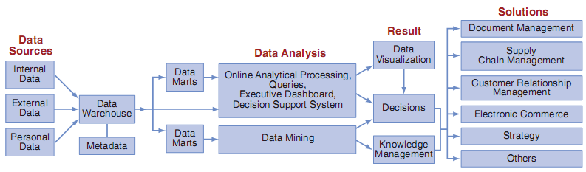
The Data Life Cycle

Slide 11
The Database Approach
Database eliminates problems of storing and accessing data.
Databases are arranged so that one set of software programs—the database management system—provides all users with access to all the data

Slide 12
The Database Approach
Database system minimizes the following problems:
Data redundancy: The same data are stored in many places.
Data isolation: Applications cannot access data associated with other applications.
Data inconsistency: Various copies of the data do not agree.

Slide 13
The Database Approach
Database system maximize the following problems:
Data security.
Data integrity: Data meet certain constraints, such as no alphabetic characters in a Social Security number ﬁeld.
Data independence: Applications and data are independent of one another (i.e., applications and data are not linked to each other, meaning that all applications are able to access the same data).

Slide 14
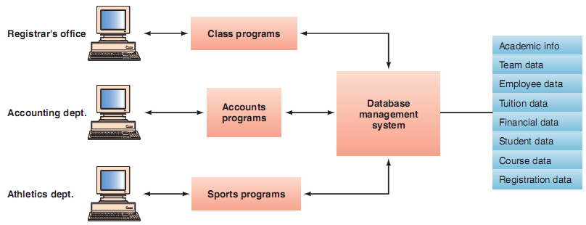
The Database Approach

Slide 15
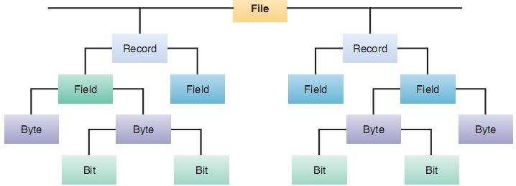
The Data Hierarchy

Slide 16
Designing the Database
Entity-Relationship Modeling.
A database management system (DBMS)
Query Languages.
Data Dictionary
Normalization

Slide 17
Data Warehousing
A repository of historical data that are organized by subject to support decision makers in the organization.
Data warehouses facilitate business intelligence activities, such as data mining, decision support, and querying applications

Slide 18
The basic characteristics of a data warehouse
Organized by business dimension or subject and contain information relevant for decision support and data analysis.
Consistent. Data in different databases may be encoded differently.
Historical. The data are kept for many years so that they can be used for identifying trends, forecasting, and making comparisons over time.
Nonvolatile. Data are not updated after they are entered into the warehouse.

Slide 19
The basic characteristics of a data warehouse
Use online analytical processing
Multidimensional.
Relationship with relational databases.

Slide 20
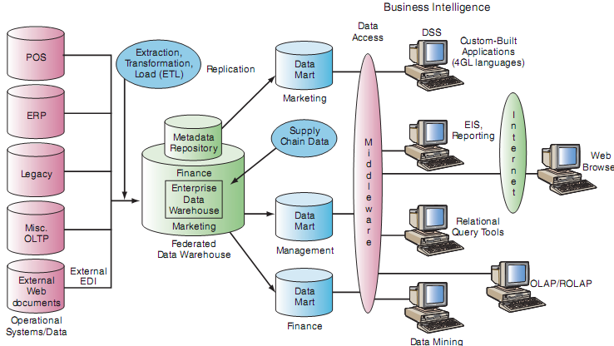
Data warehouse framework and views

Slide 21
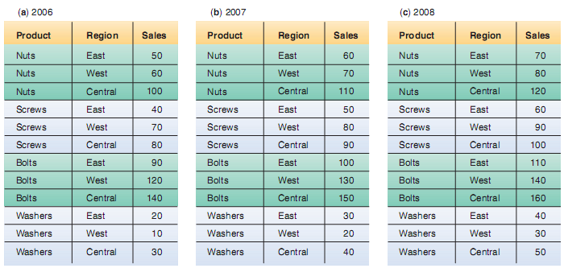
Relational databases.

Slide 22
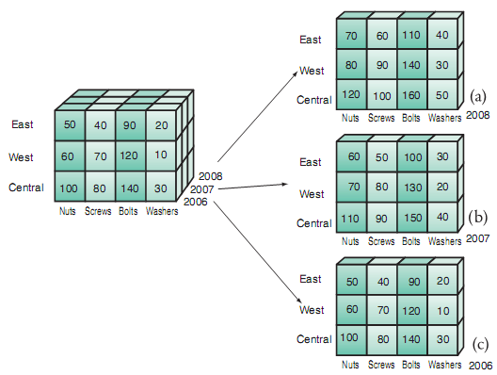
Multidimensional database

Slide 23
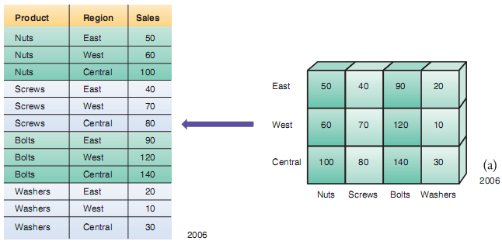
Equivalence between relational and multidimensional databases

Slide 24

Equivalence between relational and multidimensional databases

Slide 25
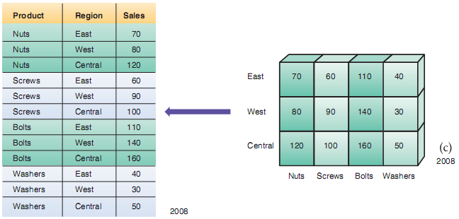
Equivalence between relational and multidimensional databases

Slide 26
Data Governance
Data governance is an approach to managing information across an entire organization.
One method used to implement data governance is master data management.
Master data management is a process that spans all organizational business processes and applications.
Master data are a set of core data, such as customer, product, employee, vendor, and geo- graphic location, that span the enterprise information systems.

